Slide 1
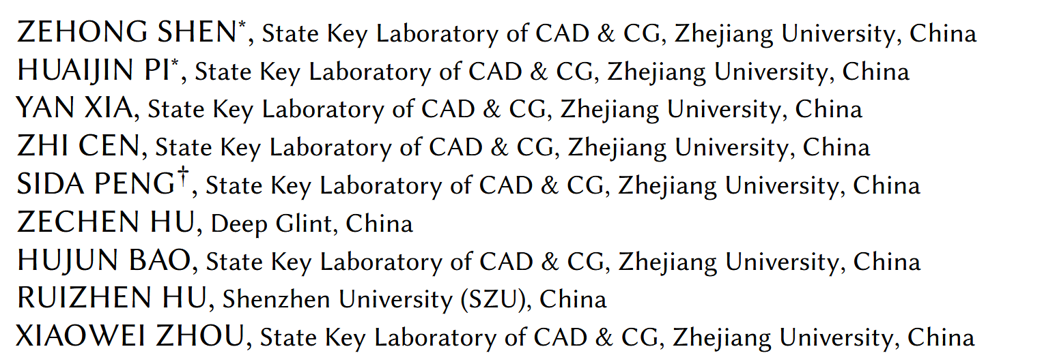
World-Grounded Human Motion Recovery via Gravity-View Coordinates
published in: SIGGRAPH-ASIA 2024
reporter: Litao Deng
Notes:
Today I’ll present a paper that introduces a new coordinate representatio

Slide 2
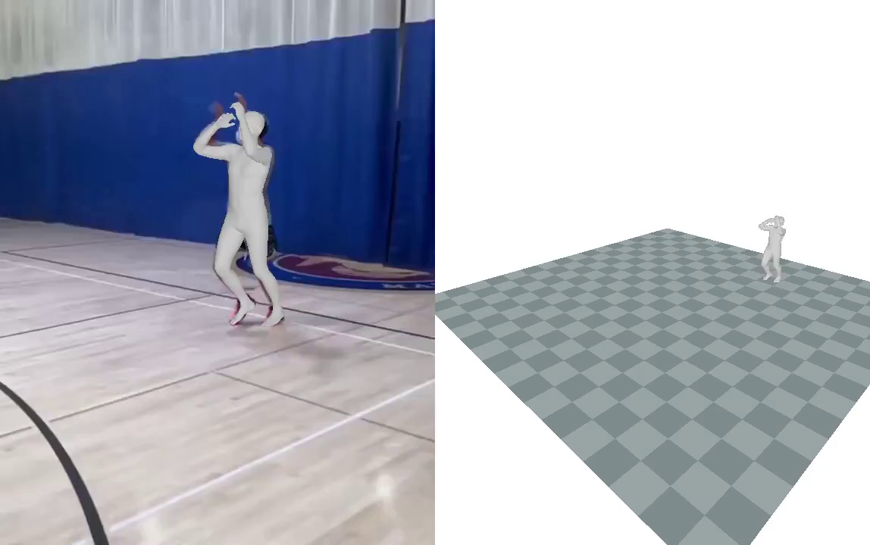
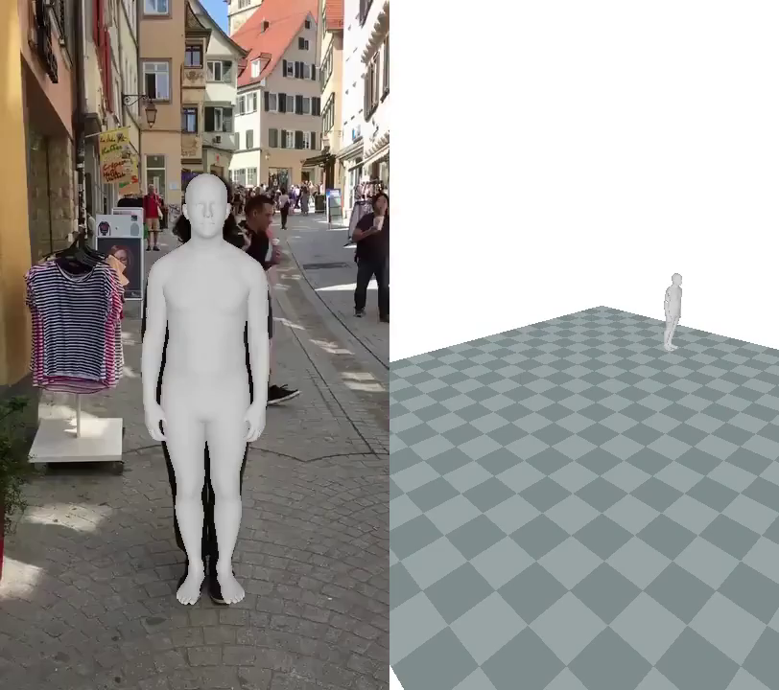
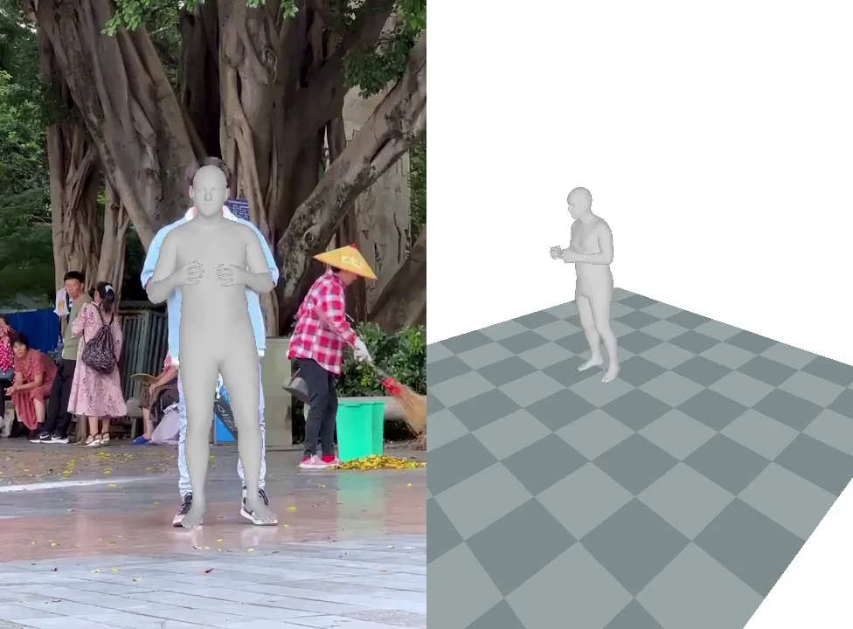
Task: Human motion recovery → SMPL in world coordinates
Challenges:
Ambiguity: defining the world coordinate system, which varies between sequences.
Drift: autoregressive rollouts accumulate errors(errors in translations and poses can accumulate)
Unstable for long sequences
Prior works (HMR2.0, GLAMR, SLAHMR, WHAM) suffer from drift or require a good initialization and heavy optimization
Notes:
Highlight that many methods can regress local SMPL pose, but placing it into world coordinates robustly is still difficult.Mention how global trajectory matters: for downstream tasks like tracking, sports analysis, AR/VR, robotics.

Slide 3
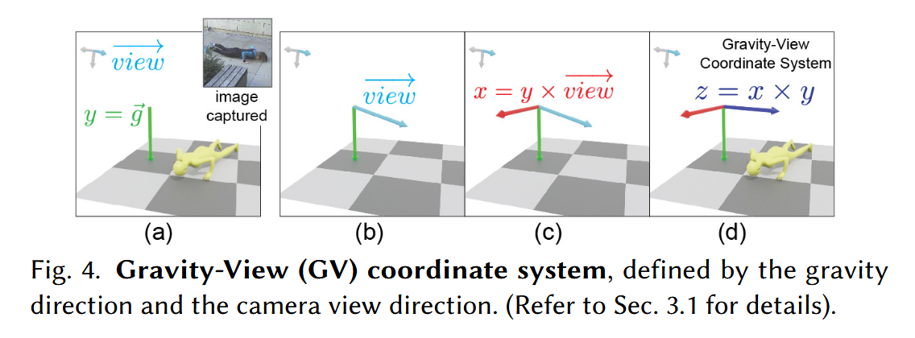
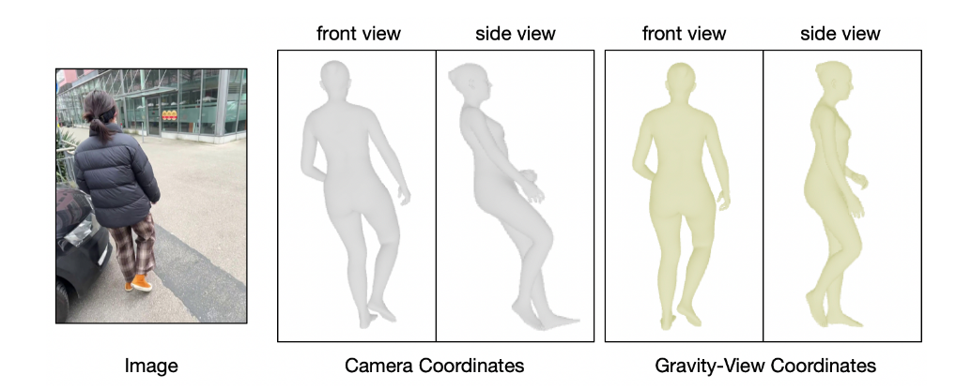
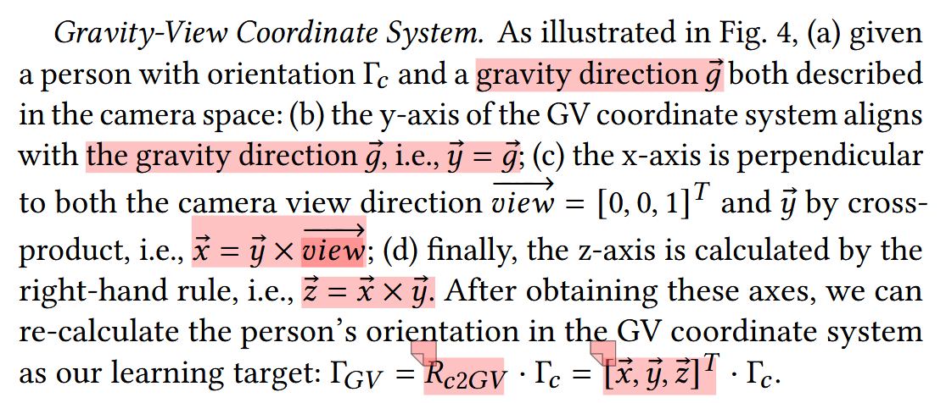
Key Ideas:
A novel Gravity-View (GV) coordinate system, defined by the gravity and camera view directions.
Insights:
humans are able to easily infer the gravity-aware human pose
given two consecutive frames, it is easier to estimate the 1-degree-of-freedom rotation around the gravity direction, compared to the full 3-degree-of-freedom rotation.
Notes:
humans can easily infer “upright vs upside-down” from a single image (gravity alignment), but yaw is ambiguous. By deferring yaw composition to a later step, the network avoids error accumulation.

Slide 4
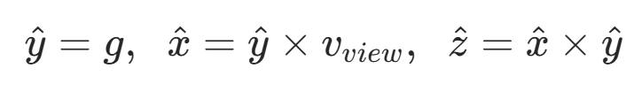
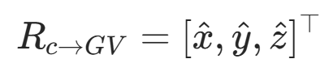
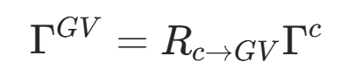
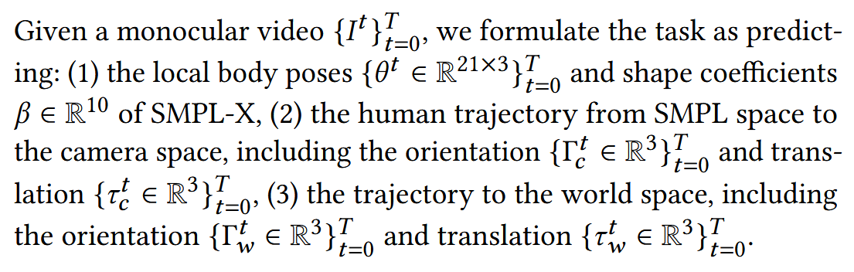
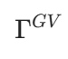
GV Construction:
From camera coordinates:
Rotation matrix:
Transform:
represents the orientation in GV space
Notes:
The letter notation in this article is quite complicated. Through this transformation, we can obtain the orientation relative to the GV coordinate system. However, the GV coordinate changes by time. So, to get the world-grounded motion, we need to obtain the transformation of GV coordinates over time.

Slide 5
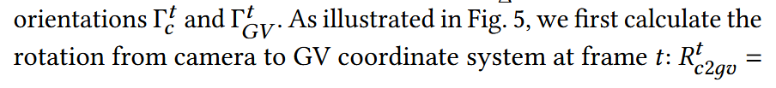
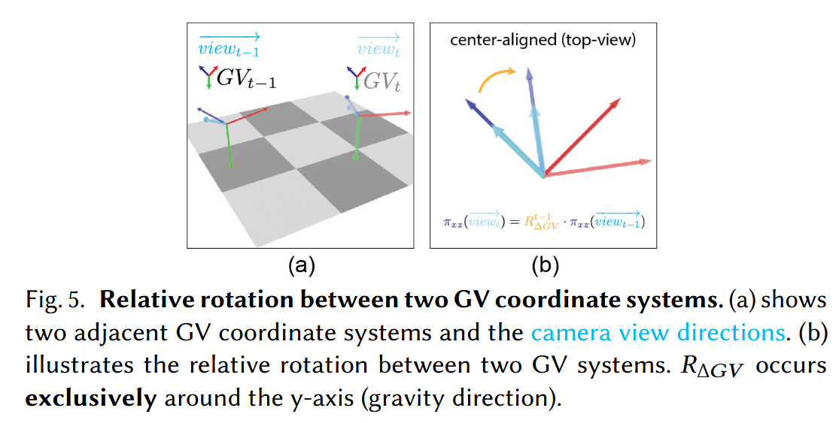
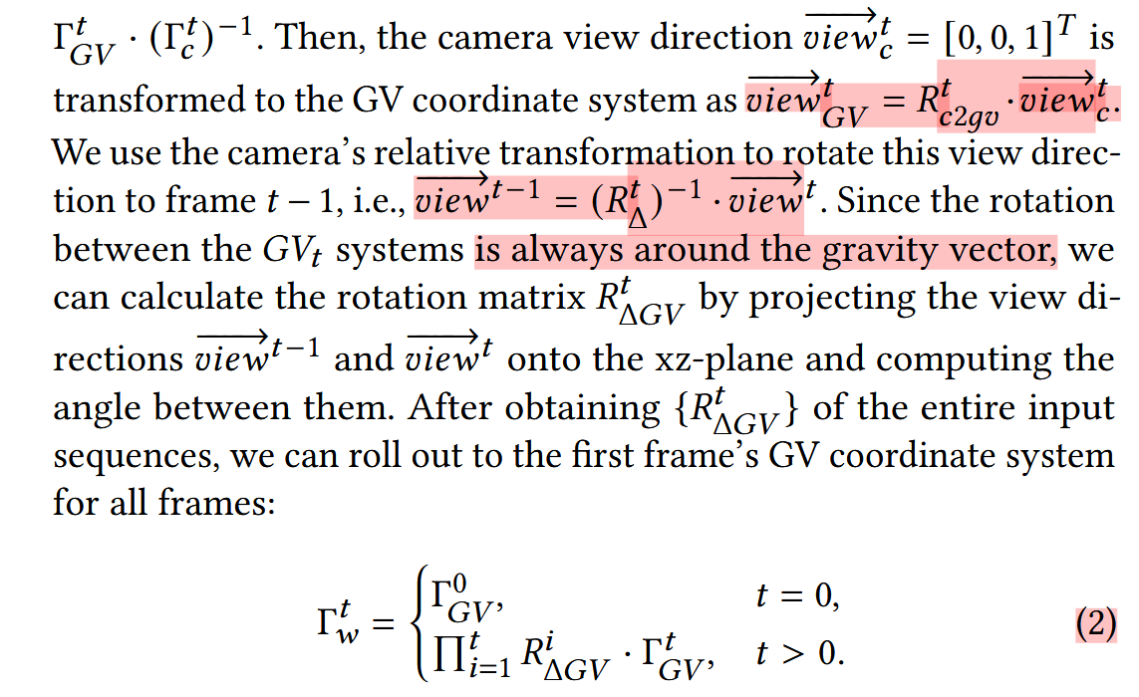

Global Trajectory Recovery：
orientation：
translation：
Notes:
The crux: per-frame GV orientations are aligned across time using yaw deltas. Emphasize robustness: only need to track yaw on the gravity-aligned plane.

Slide 6
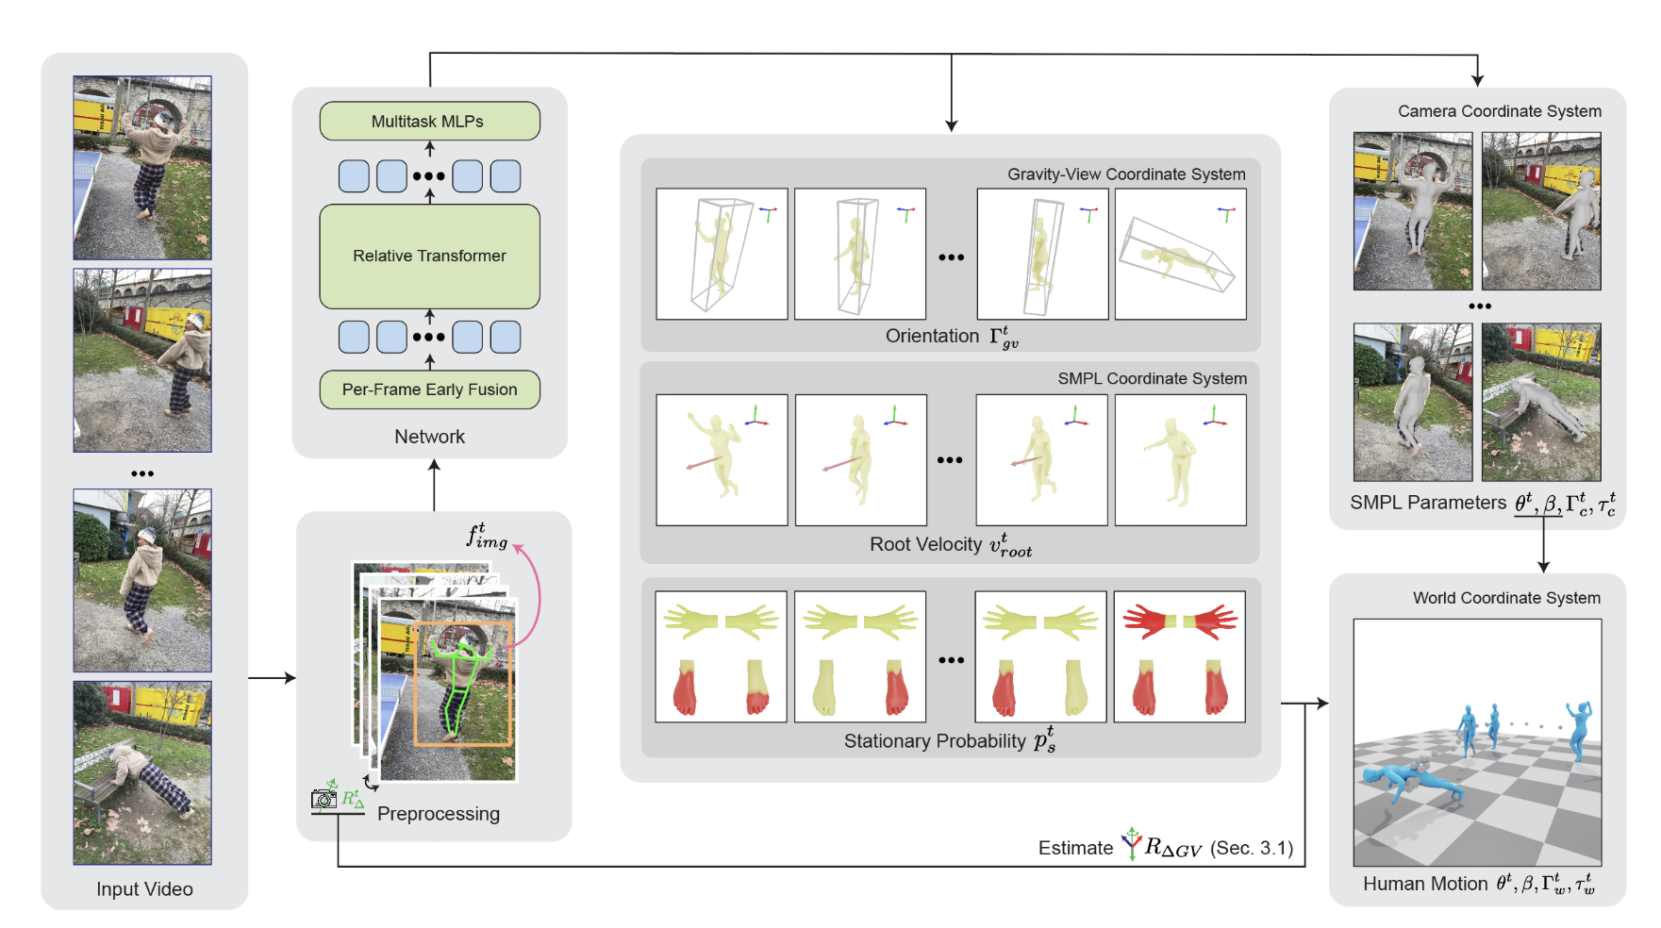
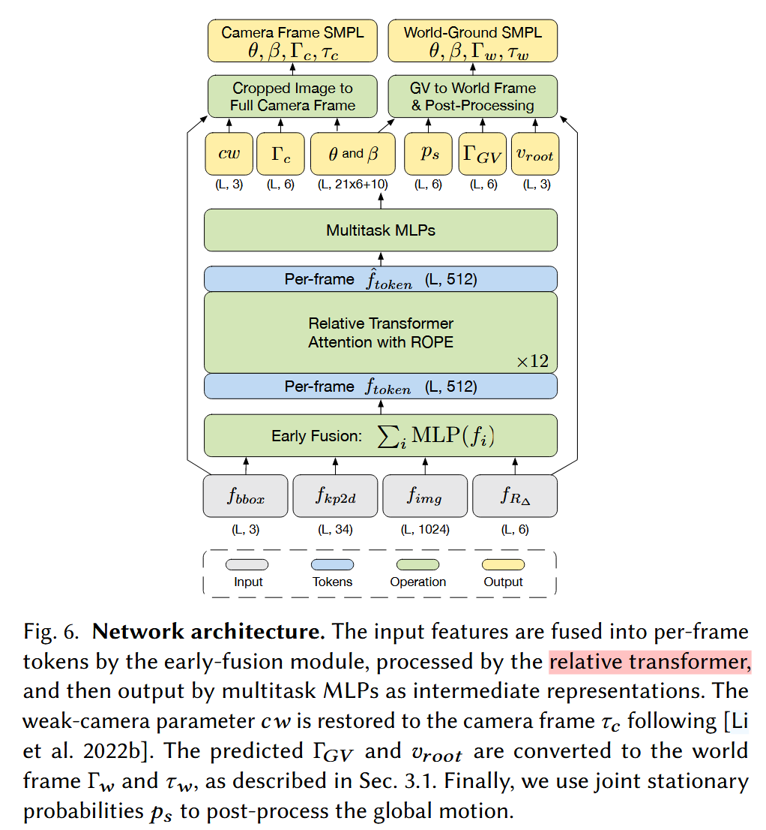
Network & Outputs:
Given a monocular video (left), following WHAM [Shin et al. 2024], GVHMR preprocesses the video by tracking the human bounding box, detecting 2D keypoints, extracting image features, and estimating camera relative rotation using visual odometry or a gyroscope.
Notes:
Given a monocular video (left), following WHAM [Shin et al. 2024], GVHMR preprocesses the video by tracking the human bounding box, detecting 2D keypoints, extracting image features, and estimating camera relative rotation using visual odometry or a gyroscope. GVHMR then fuses these features into per-frame tokens, which are processed with a relative transformer and multitask MLPs. The outputs include: (1) intermediate representations (middle), i.e. human orientation in the Gravity-View coordinate system, root velocity in the SMPL coordinate system, and the stationary probability for predefined joints; and (2) camera frame SMPL parameters (right-top). Finally, the global trajectory (right-bottom) is recovered by transforming the intermediate representations to the world coordinate system, as described in Sec. 3.1
Post-processing. The proposed network learns smooth and realistic global movement from the training data. Inspired by WHAM, we additionally predict joint stationary probabilities to further refine the global motion. Specifically, we predict the stationary probabilities for the hands, toes, and heels, and then update the global translation frame-by-frame to ensure that the static joints remain at fixed points in space as much as possible. After updating the global translation, we calculate the fine-grained stationary positions for each joint (see the algorithm in the supplementary). These target joint positions are then passed into an inverse kinematics process to solve the local poses, mitigating physically implausible effects like foot-sliding. We use a CCD-based IK solver [Aristidou and Lasenby 2011] with an efficient implementation [Starke et al. 2019].

Slide 7
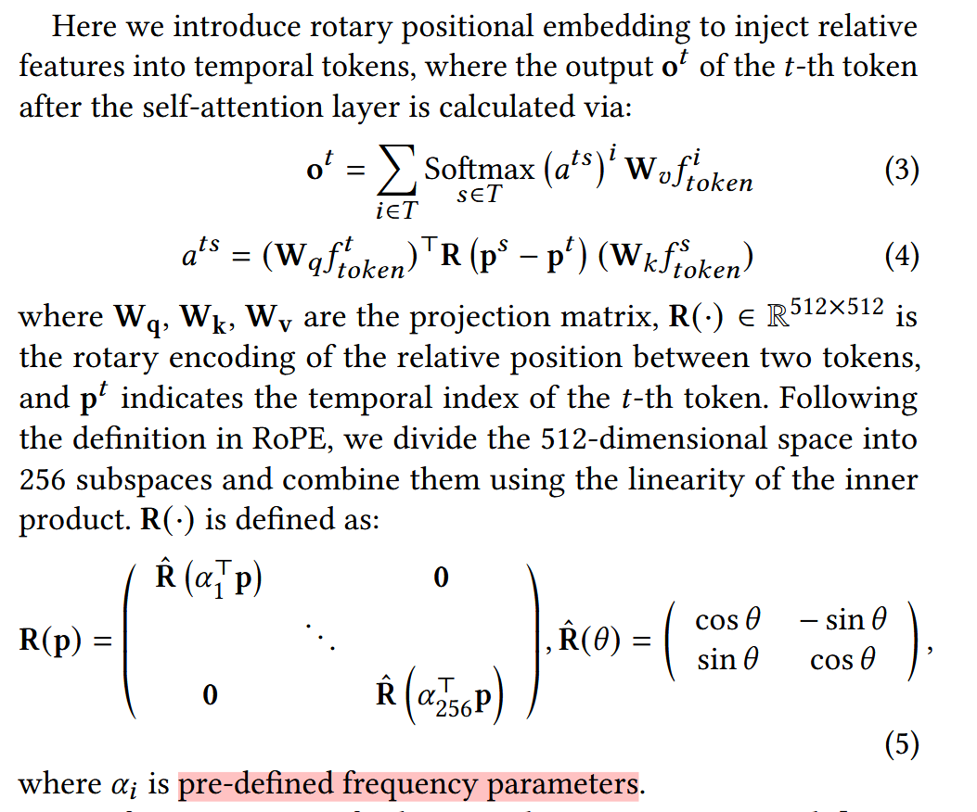
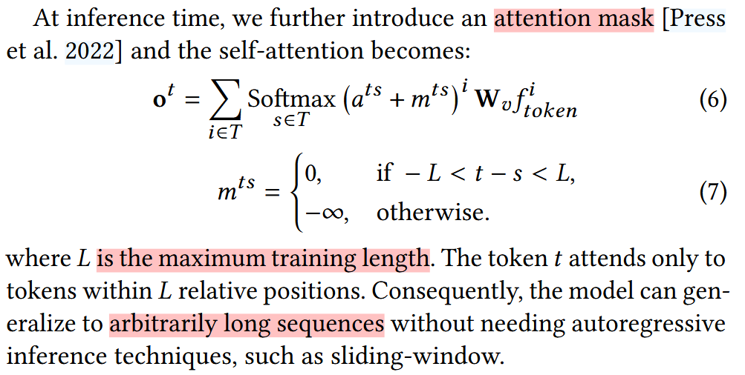
Rotary Positional Embedding (RoPE) & Attension Mask
Standard positional encoding struggles with long sequences
Notes:
RoPE is not novel in this paper, but it is an essential design choice for long-sequence stability

Slide 8
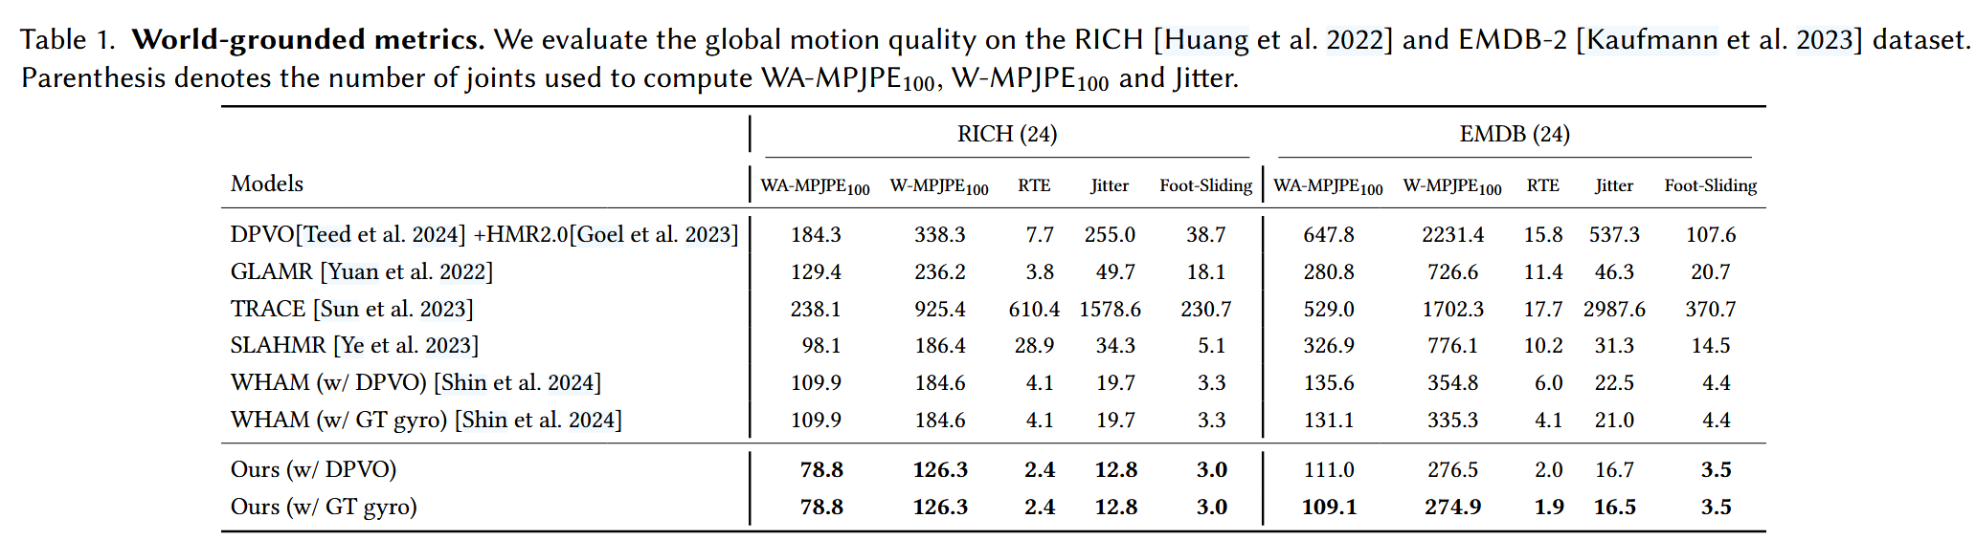
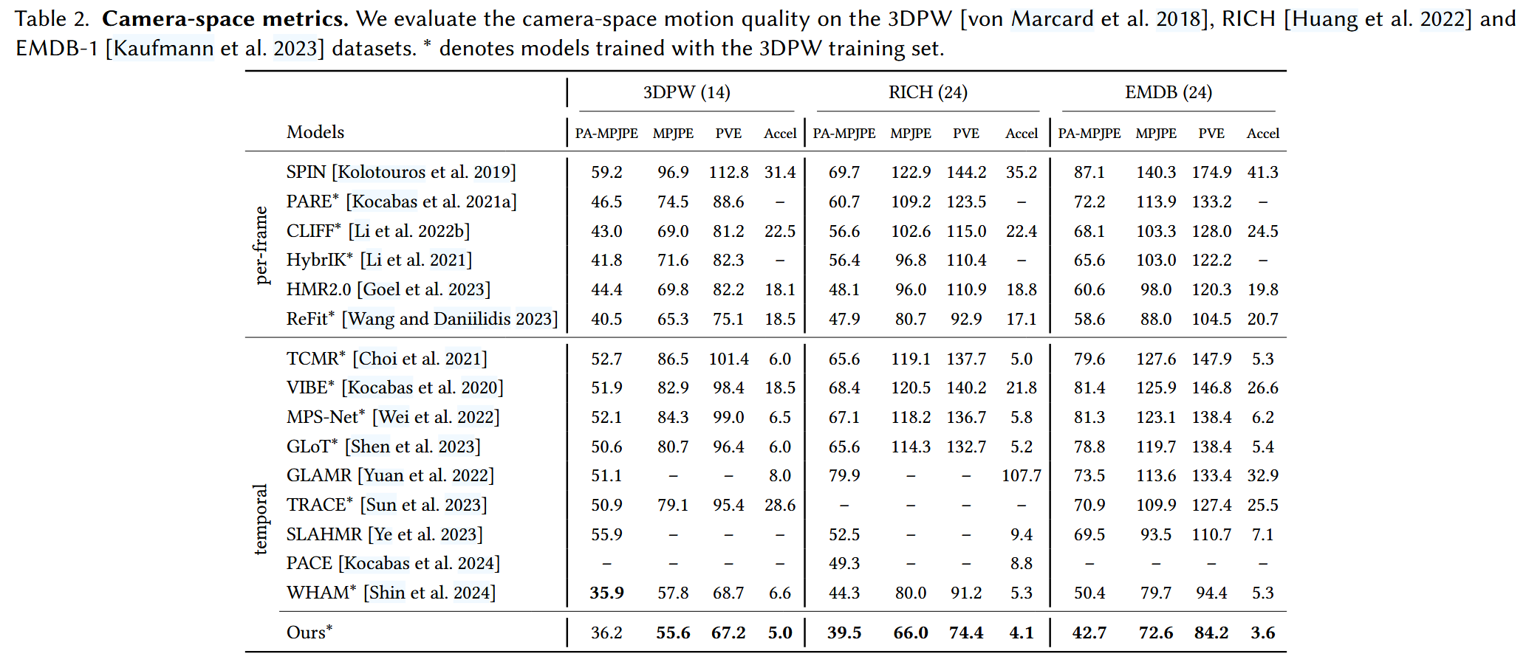
Experiments & Results:
Experiments & Results:

Slide 9
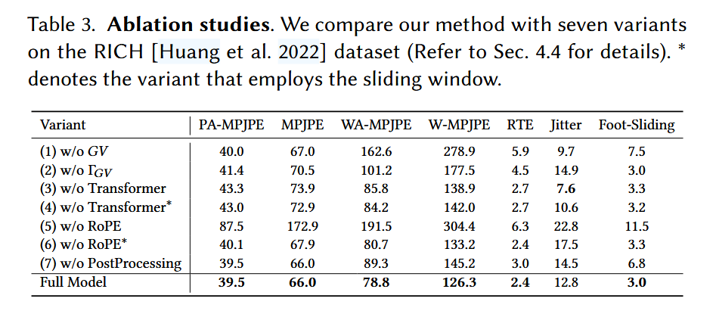
Ablation Study
w/o GV: Removing gravity alignment slightly hurts camera-space metrics and yields poor non-aligned world motion.
w/o ΓGV: Dropping GV orientation causes major world-coordinate errors due to accumulation.
w/o Transformer / Transformer*: Replacing the transformer with convolution (with or without sliding window) leads to poor performance, showing the transformer’s superiority.
w/o RoPE / RoPE*: Absolute positional encoding (with or without sliding window) generalizes poorly on long sequences.
w/o Post-Processing: Skipping post-processing notably degrades global accuracy.
Notes:
(1) w/o GV : when predicting human motion solely in the camera coordinate system, the metrics drop slightly. This suggests that gravity alignment improves camera-space human motion estimation accuracy. For this variant, we can further recover a non-gravity-aligned global motion, which performs poorly in global metrics. (2) w/o ΓGV : when predicting the relative global orientation from frame to frame, the world-coordinate metrics drop substantially, indicating that the model suffers from error accumulation in this configuration. (3) w/o Transformer: adopting a convolutional architecture yields poor performance, highlighting that our transformer architecture is more effective. (4) w/o Transformer∗: when applying a convolutional architecture with a sliding windowinference strategy, the performance remains similarly poor, further validating the superiority of our transformer approach. (5) w/o RoPE: substituting RoPE with absolute positional encoding leads to very poor results. This is primarily because absolute positional embedding struggles to generalize well in long sequences. (6) w/o RoPE∗: even when using absolute positional embedding with a sliding window inference strategy, the results are still worse than our approach, confirming the inadequacy of this embedding strategy. (7) w/o Post-Processing: Omitting the postprocessing step causes a significant increase in global metrics, demonstrating that our postprocessing strategy substantially enhances global accuracy. Fig. 10 demonstrates that each component of our approach contributes to the overall performance.

